Slide 1
Anatomy of a Comparison
From Description to Causation Week 14 - CCJS 418E

Slide 2
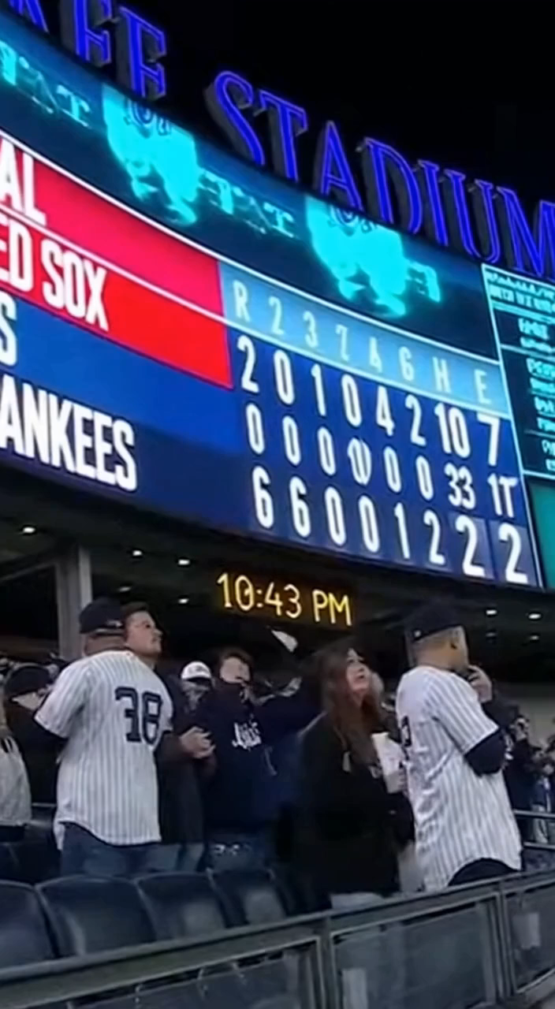
Two Ways to Ask the Same Question
Version A: "Are there more noise complaints on days with Yankees games?"
Version B: "Do Yankees games cause more noise complaints?"
Same data. Same comparison. Different questions.

Slide 3

Why This Matters
Version A = Descriptive (What happened?)
Version B = Causal (Why did it happen?)
Policy decisions need Version B answers
But Version B is much harder to prove
Which version is YOUR final project asking?

Slide 4
What Does "Cause" Mean?
"Yankees games caused more noise" means:
If the game hadn't happened, there would have been less noise
This is counterfactual thinking — asking "what would have happened otherwise?"
The Problem:
• We can't observe both worlds
• We only see what actually happened (game + noise)
• We never see what would have happened without the game
So what do we do?
• We use comparisons to approximate the "what if"
• Non-game days are our best guess at "what would have happened"

Slide 5
Your Projects Ask Causal Questions
"Do NFL games lead to more crime?"
"Has tough-on-crime deterred violent crime?"
"Does crime increase during holidays?"
These are all Version B questions.
Most of our class we have talked about Version A type analyses.
Today, we’ll talk about how to approach these questions through a causal lens.

Slide 6
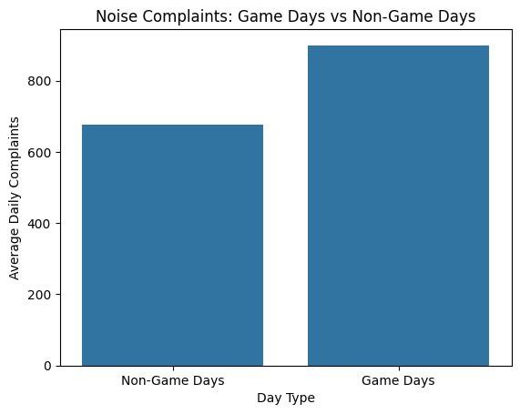
The Basic Comparison
Game days vs. Non-game days
Finding: 33% more noise complaints on game days
This answers Version A.
Does it answer Version B?

Slide 7
The Fundamental Problem of Causal Inference
It is impossible to observe BOTH (for example):
The outcome when a person gets treatment
The outcome when that same person doesn’t get the treatment (or gets a placebo)
In the 311 example, we don’t see:
Noise complaints when the Yankees play a game in the Bronx on a particular day
Noise complaints when the Yankees DON’T play a game in the Bronx on that day

Slide 8
Reality of Causal Inference
So what we wind up doing is, comparing:
Noise complaints when the Yankees play a game in the Bronx on a particular day
Noise complaints when the Yankees play a game in the Bronx on a different day

Slide 9
So, What Else Could Explain This?
Before I show you alternatives...
What do YOU think could explain this besides the games themselves?
In other words, what might be different about a day when the Yankees play versus a day when they don’t play?

Slide 10
Alternative 1: Day of Week Effect
Yankees games cluster on weekends
Weekends already have more noise (parties, people home)
Maybe it's the WEEKEND, not the GAME
How would we test this?

Slide 11
Alternative 2: Seasonal Effect
Baseball = April to October = warm weather
Windows open, outdoor activities, summer parties
Maybe it's SUMMER, not the GAME
Is this convincing? Why or why not?

Slide 12
Alternative 3: Citywide Trend
Maybe NYC is just getting noisier over time
Construction, population growth, more nightlife...
Game days might coincide with noisier periods by chance.
If the whole city is getting noisier and game days happen to fall
during those times, we'd see a pattern even if games have nothing to do with it.
How could we check if it's a general NYC trend vs. something specific to games?

Slide 13
Alternative 4: Location
Maybe areas near Yankee Stadium are just noisier places in general
The Bronx has bars, restaurants, public transit hubs
Maybe it's noisy regardless of whether there's a game
If the Bronx is inherently noisy, we'd see more complaints
there on ALL days, not just game days
How could we separate "the Bronx is noisy" from "games make it noisier"?

Slide 14
Alternative 5: Reporting Behavior
Maybe games don't cause more NOISE, just more COMPLAINTS
Residents primed to be annoyed on game days
Lower tolerance = more calls to 311
The noise level could be the same!
Can we distinguish 'more noise' from 'more reporting'?

Slide 15
The Challenge
One comparison can't rule out all alternatives
We need multiple comparisons
Each addresses different concerns
Let's build our toolkit...

Slide 16
Strategy 1: Compare to Yourself
Same place, different times
Compare: Bronx on game days vs. Bronx on non-game days
✓ What this rules out:
"Maybe the Bronx is just a noisy place"
We're comparing the Bronx to itself — location factors cancel out.
✗ What this doesn't rule out:
• Day of week — maybe games fall on weekends, and weekends are noisier
• Season — maybe baseball season = summer = noisier
• Citywide excitement — maybe all of NYC gets noisier on game days

Slide 17
Strategy 1: Results
Bronx: 39% increase on game days
This rules out: "The Bronx is just a noisy place"
This doesn't rule out:
- Day of week effects
- Seasonal effects
- Citywide trends
What time-varying factors could still explain this?

Slide 18
Strategy 2: Compare to Someone Else
Same time, different places
On game days, does the Bronx have a higher share of complaints than usual?
✓ What this rules out:
"Maybe it's just weekends" or "Maybe it's just summer"
If both boroughs increase proportionally, shares stay the same.
If Bronx's share goes UP, something specific to Bronx is happening.
✗ What this doesn't rule out:
• Population — Brooklyn has more people
• Housing — different building types
• Who complains — some neighborhoods call 311 more

Slide 19
Strategy 2: Results
Bronx game day average: 431 complaints
Brooklyn game day average: 472 complaints
Wait - Brooklyn is HIGHER?
Raw counts are misleading.
Why might raw counts be misleading here?

Slide 20
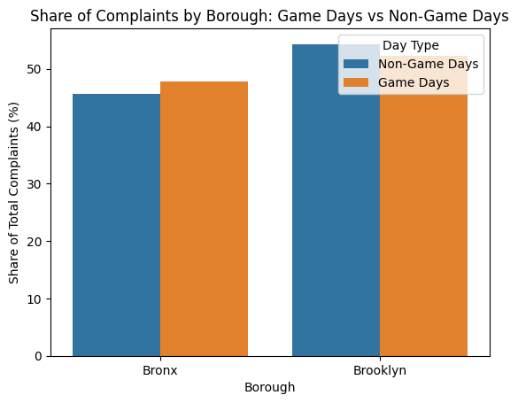
Strategy 2: Results
Share of complaints by borough:
On NON-GAME days:
Bronx: 46% Brooklyn: 54%
On GAME days:
Bronx: 48% Brooklyn: 52%
Bronx's share increases by 2 percentage points on game days.
Something specific to the Bronx is happening on game days — not just a general "game days are noisier" effect.
What is one limitation of this approach, at least as shown here?
What could still explain this shift besides the stadium?

Slide 21
The Problem with Each Strategy
Each strategy rules out some alternatives but not others:
Strategy 1 (Compare to yourself):
✓ Rules out place-based explanations
✗ Can't rule out time-based explanations (weekends, summer, citywide)
Strategy 2 (Compare to someone else):
✓ Rules out time-based explanations
✗ Can't rule out place-based explanations (population, housing)
The insight: What if we combined them?

Slide 22
Strategy 3: Difference-in-Differences
Compare the CHANGE in Bronx to the CHANGE in Brooklyn
If citywide trend exists:
Both change equally = Difference is 0
If stadium has extra effect:
Bronx changes MORE = Difference > 0

Slide 23
Difference-in-Differences
Borough | Non-Game | Game Day | Change
Bronx | 310 | 431 | +121 (+39%)
Brooklyn | 370 | 472 | +102 (+28%)
Difference |  |  | +19 (+11%)
The 11% = stadium effect above citywide trend
What does this 11% represent? What does it rule out?

Slide 24
What Diff-in-Diff Rules Out
By comparing changes, diff-in-diff rules out both problems:
✓ "Maybe it's just weekends/summer"
If game days are noisier everywhere, both boroughs increase equally — cancels out.
✓ "Maybe the Bronx is just noisier"
We compare changes, not levels. If Bronx is always noisier, that cancels out.
✓ "Maybe all of NYC gets excited for Yankees games"
Brooklyn captures the citywide effect. We subtract it out.
The ~11% extra in the Bronx = the localized stadium effect

Slide 25
But We're Still Not Done
Diff-in-diff addresses time and place confounds
But what if our OUTCOME is the problem?
What if something about game days affects
ALL 311 complaints, not just noise?

Slide 26
The Placebo Test
Test an outcome that SHOULDN'T be affected
If Yankees games cause NOISE complaints...
They shouldn't cause HEATING complaints
No plausible mechanism connecting baseball to heating!
Why is this a good placebo? What makes a good placebo?

Slide 27
Placebo Logic
If heating complaints ALSO spike on game days:
• Something else is going on
• Maybe people just call 311 more on game days?
• Our comparison might be picking up the wrong thing
If heating complaints show NO game-day effect:
• Strengthens the noise finding
• Rules out "people just complain more on game days"
• The effect is specific to noise — which makes sense!

Slide 28
Placebo Results: Noise vs. Heating
Metric | Noise | Heating
Overall game day effect | +33% | -75%
Bronx effect | +39% | -76%
Brooklyn effect | +28% | -75%
Diff-in-diff | +11% | -1%
Heating drops (baseball = summer = no heating needed). No Bronx-specific effect!

Slide 29
Interpreting the Placebo
Noise: Strong positive effect, especially in Bronx
Heating: Strong NEGATIVE effect (summer!), NO Bronx pattern
The diff-in-diff for heating is essentially zero (-1%)
This confirms: The noise pattern is SPECIFIC, not a general reporting or data artifact

Slide 30
What Could Still Explain This?
Even after diff-in-diff and the placebo test, we haven't proven causation.
Someone could still argue:
• "Maybe Bronx residents are extra sensitive to game-day noise"
They tolerate normal noise but complain more when it's game-related
• "Maybe there are other events near Yankee Stadium on game days"
Food vendors, street performers, traffic — not the game itself
• "Maybe it's the fans traveling through, not the game"
Subway crowds, honking, pregame gatherings in the neighborhood
• "Maybe Brooklyn isn't a good comparison"
What if Brooklyn has its own game-day dynamics we don't know about?
This is why we say "closer to Version B" — not proof, but a stronger case.

Slide 31
Applying to Your Projects
Example 1: "Do NFL games lead to crime?"
Placebo: Do NFL games lead to... library checkouts?
Example 2: "Does crime increase during holidays?"
Placebo: Do pothole complaints increase during holidays?
What would be a good placebo for YOUR project?

Slide 32
Building a Causal Case
Step What It Rules Out
Basic comparison
→ Nothing yet — just shows a pattern exists
Compare to yourself
→ "Maybe the Bronx is just noisy"
Compare to someone else
→ "Maybe it's just weekends/summer"
Diff-in-diff
→ Both place AND time explanations
Placebo test
→ "Maybe people just complain more on game days"
Each step rules out more alternatives → stronger case for causation

Slide 33
For Your Final Project
What is your main comparison?
What are 2-3 alternative explanations?
Can you compare to yourself AND someone else?
What would be your placebo outcome?

